Slide 1
Topics
1. Installation and basic useage
2. Obtain data source
3. Data visulization
4. Useful tool (Google Distance Matrix API)

Slide 2
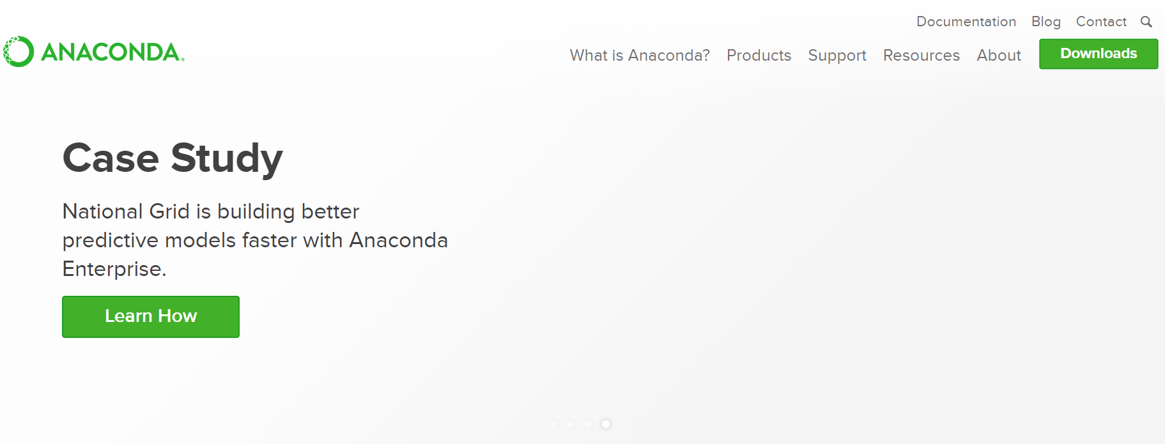
Installation and basic useage
www.anaconda.com

Slide 3
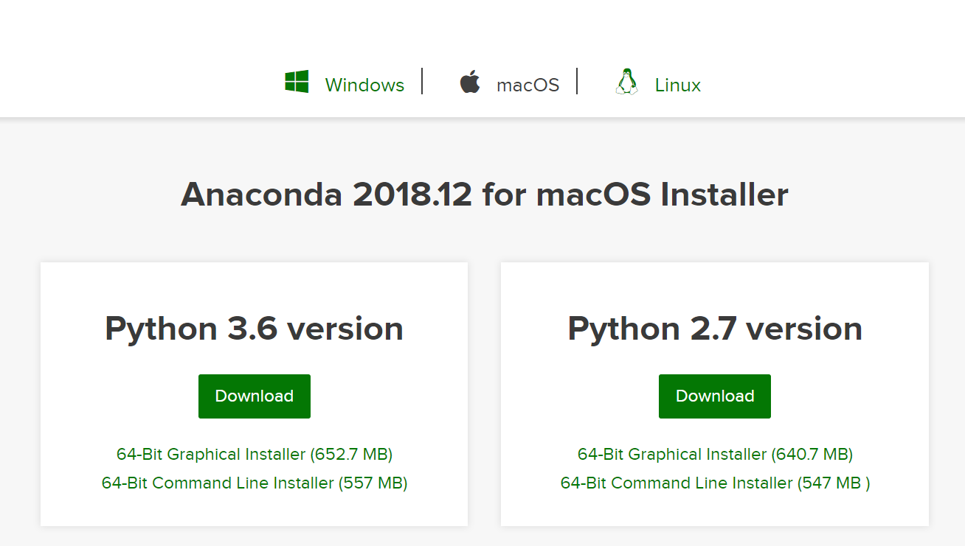
Installation and basic useage

Slide 4
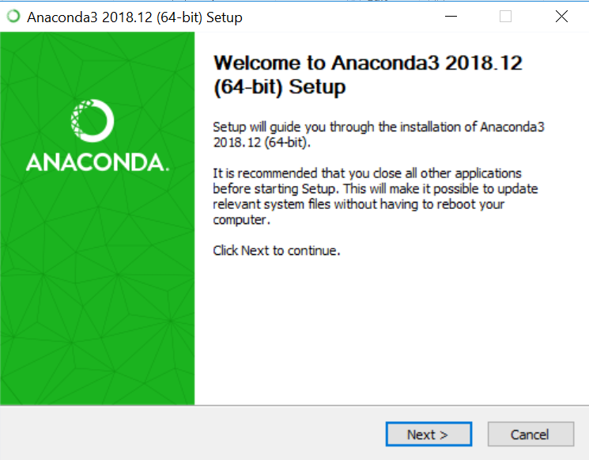
Installation and basic useage
Windows

Slide 5
Installation and basic useage
Windows

Slide 6
Topics
1. Installation and basic useage
2. Obtain data source
3. Data visulization
4. Useful tool (Google Distance Matrix API)

Slide 7
Topics
1. Installation and basic useage
2. Obtain data source
3. Data visulization
4. Useful tool (Google Distance Matrix API)

Slide 8
Topics
1. Installation and basic useage
2. Obtain data source
3. Data visulization
4. Useful tool (Google Distance Matrix API)

Slide 9
Topics
1. Installation and basic useage
2. Obtain data source
3. Data visulization
4. Useful tool (Google Distance Matrix API)

Slide 10
Topics
1. Installation and basic useage
2. Obtain data source
3. Data visulization
4. Useful tool (Google Distance Matrix API)

